Slide 1


Stocksholm excursion
Co₂olBricks – Kiinko excursion
to Stockholm
Virpi Slotte

Slide 2


Co2olBricks – Kiinko excursion to Stocksholm
Time 22. -24.4. 2013
Participants:
Arto Köliö, Researcher, Resercher, Tampere University of Technology (TUT), Civil Engineering, Department of Structural Engineering
Seija Linnanmäki, Architect in Chief, National Board of Antiquities, Cultural Environment Protection, Restoration Policy and Guidance
Aimo Nissi, Architect, Lecturer, University of Aalto
Toni Pakkala , Resercher, Tampere University of Technology (TUT), Civil Engineering, Department of Structural Engineering
Markku Rantama, Senior Expert, Finnish Real Estate Federation (FREF)
Markku Rintala, Construction refurbisher, Rintala ky
Jukka Sainio, Managing Director, Property Manager, Sainio Oy
Liisa Sainio, Architect, ARK-Suunnittelu Liisa Sainio
Virpi Slotte, Project Manager, Kiinko- Real Estate Education
Daniela Scherz, Co2olBricks Project Manager, Ministry of Culture, Department for Heritage Preservation, Hamburg
Tomas Örn, Co2olBricks Project Manager, Stockholm City museum
Lisa Sarbin, Co2olBricks Project Manager, Stockholm City museum

Slide 3
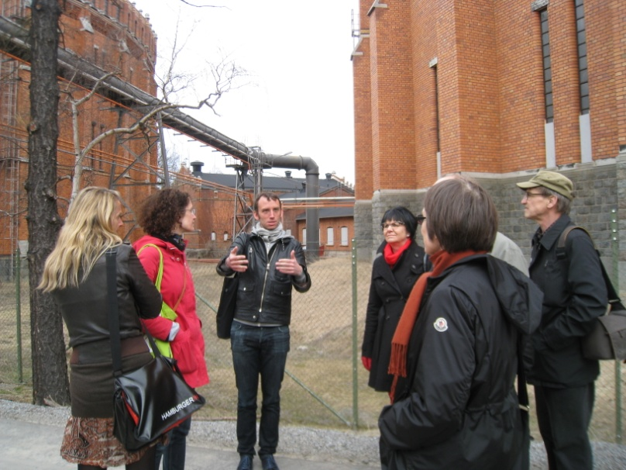
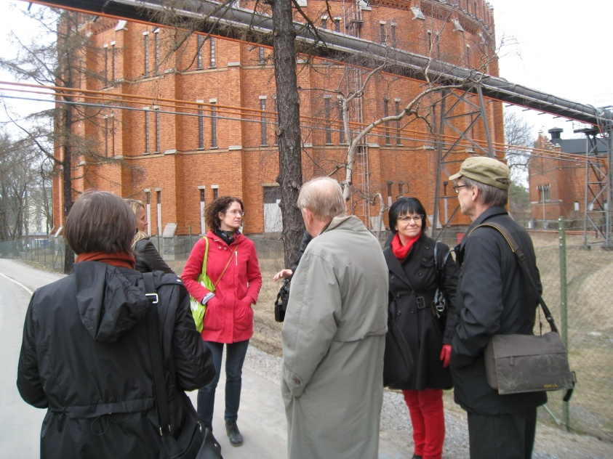
Gaswork area in Hjorthagen
Tomas Örn from the Stockholm City museum talks about the production in the gasworks area. The area is part of the city’s vision of a world-class Stockholm by 2030.
The historic industrial buildings designed by Ferdinand Boberg in the late nineteenth century will be transformed with the focus on culture, education and retail.

Slide 4
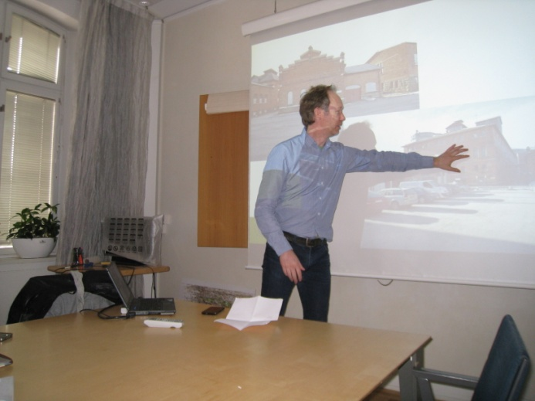
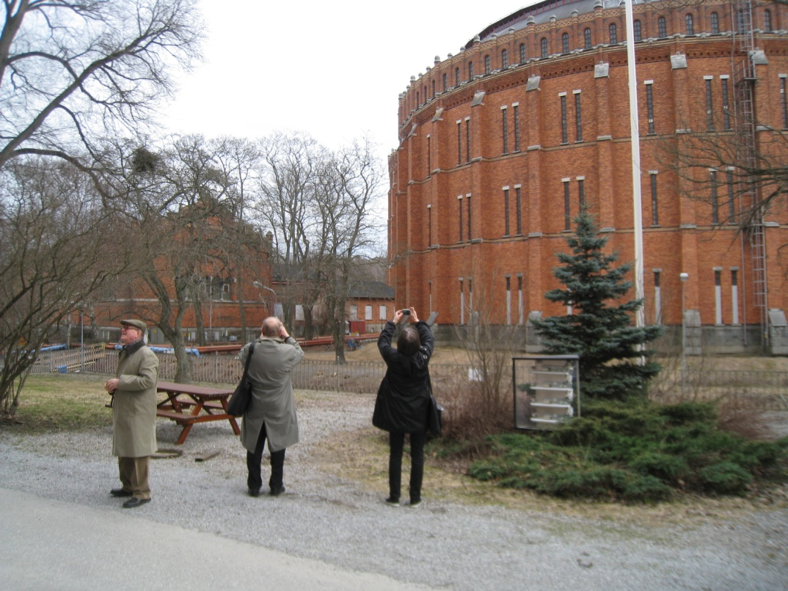
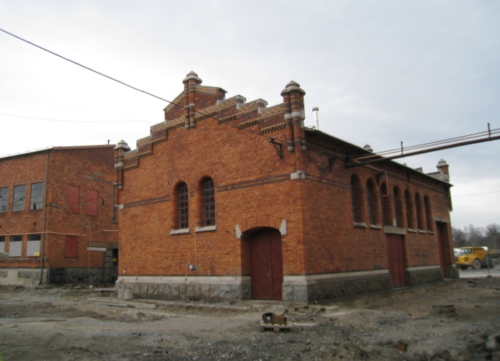
From industrial to residential
The area consists of around 30 buildings, five of which are circular gas holders from three generations of the works. Gas has been produced here for over 100 years.

Slide 5
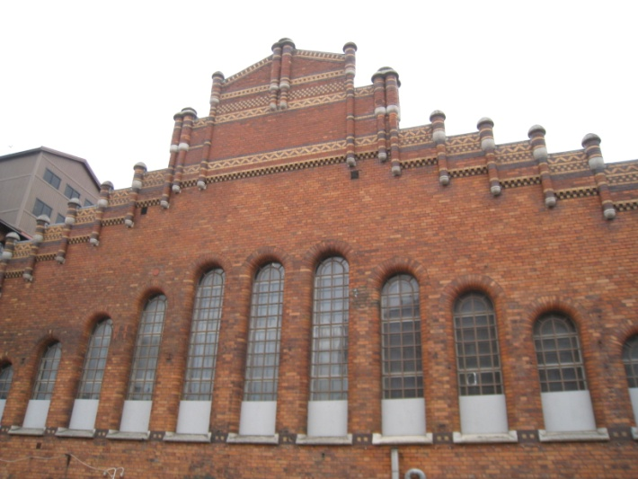
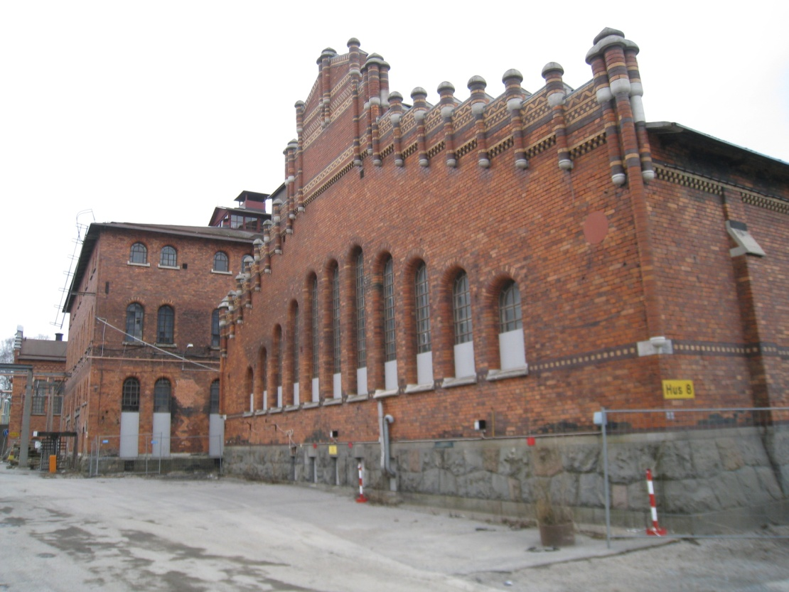
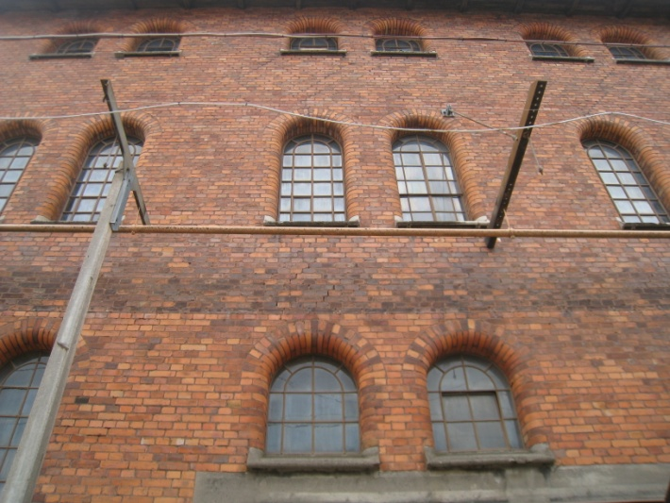
Major architectural and historic value
The industrial and urban character of the gasworks, which is of major architectural and historic value, is unique in Sweden.
By 2020 over 6000 homes will have been built and Horthagen will have 15,000 new residents.

Slide 6
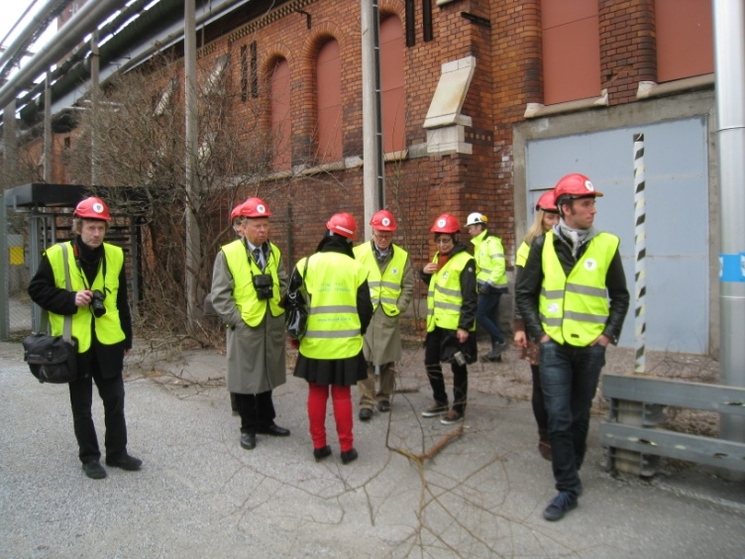
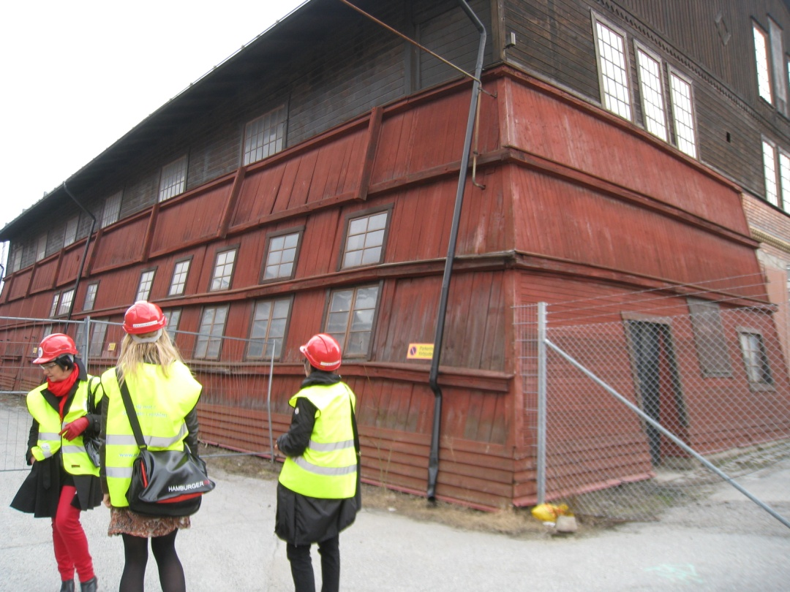
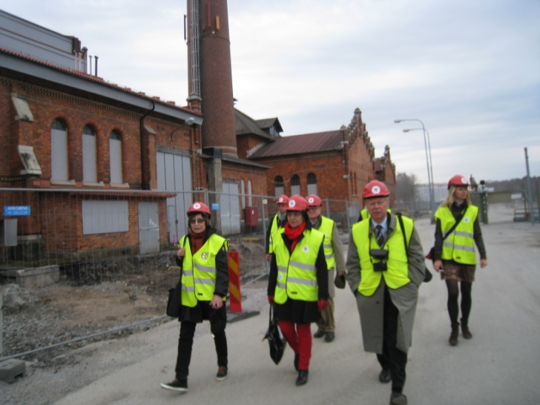
Environmental profile
The overall objective is a climate-adapted and fossil fuel-free urban district by 2030, in which carbon dioxide emissions are lower than 1.5 tonnes per person per year by 2020.

Slide 7
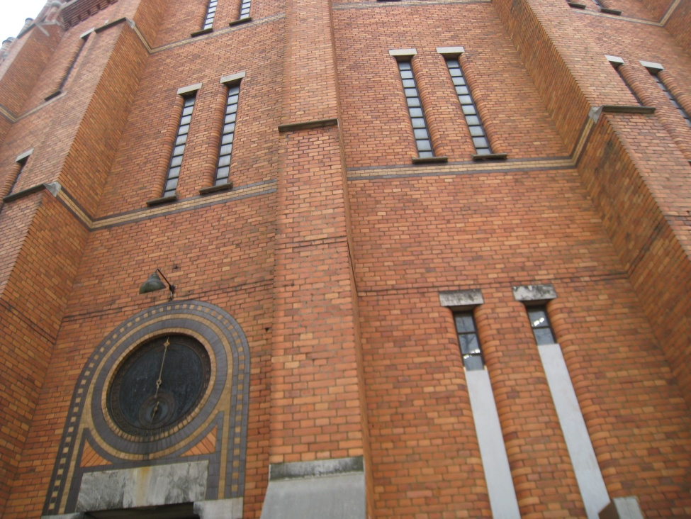
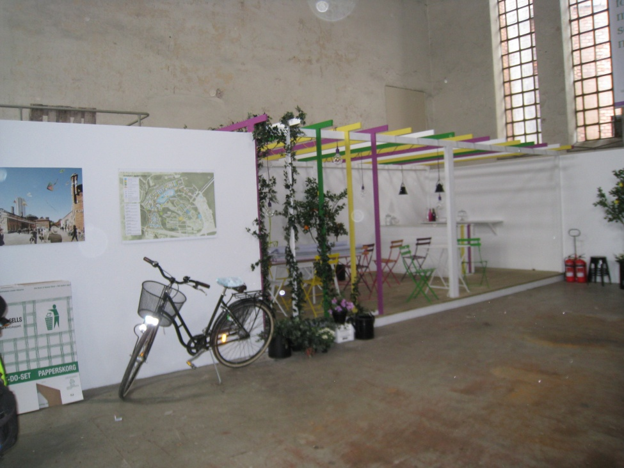
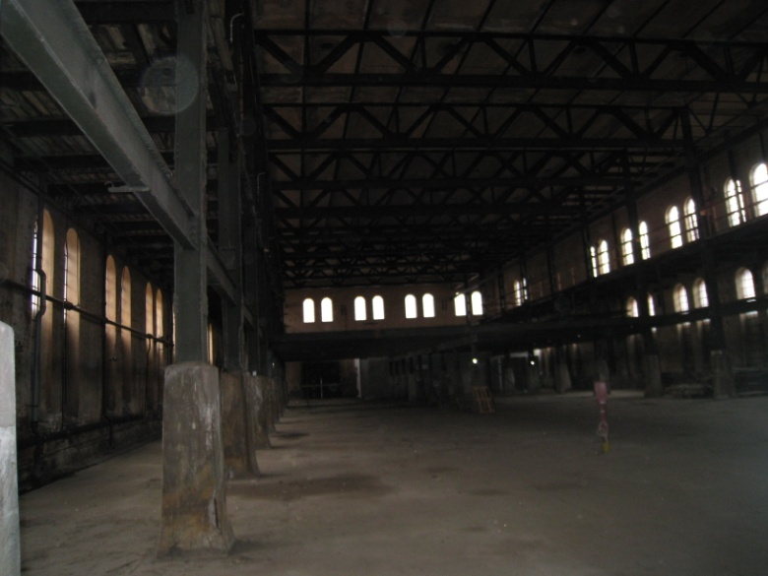
From gasworks to artwork
Realising the vision is a huge amount of work.
Closed eco-cycle solutions, an energy supply based on renewable energy and energy-efficient homes are important ingredients in realising the vision of a world-class environmental urban district.

Slide 8
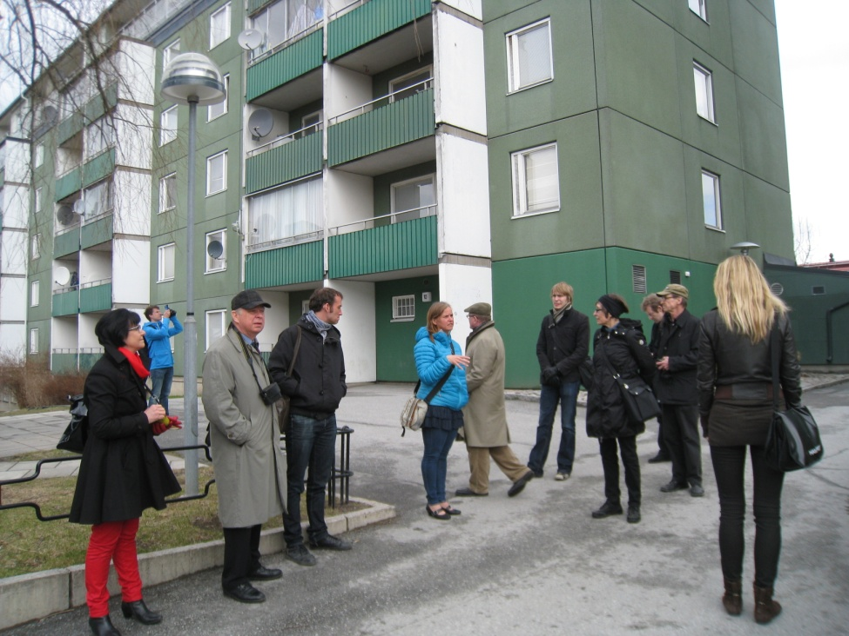
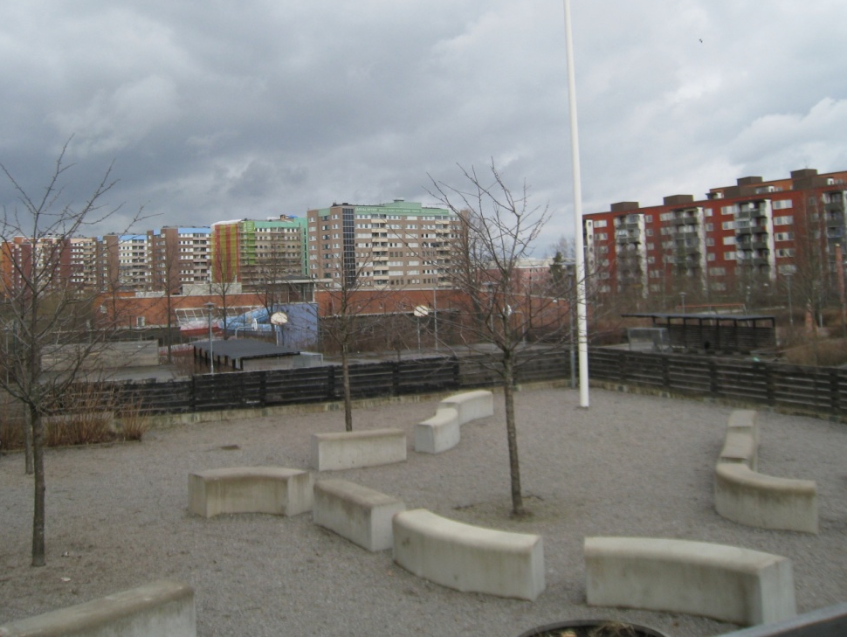
Sustainable Järva
One third of the homes in Sweden were built as part of the Million Homes Programme in the 1960s and ´70s. More than 200 million Europeans live in similar properties.
Many these buildings are shabby and in need of renovation, and their energy consumption needs to be at least halved to meet today’s demands.

Slide 9
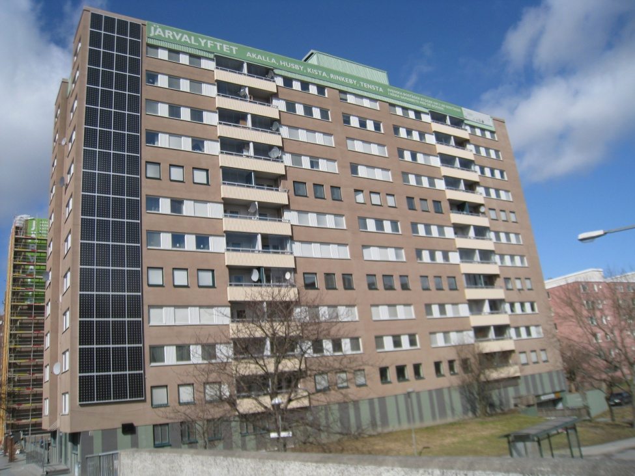
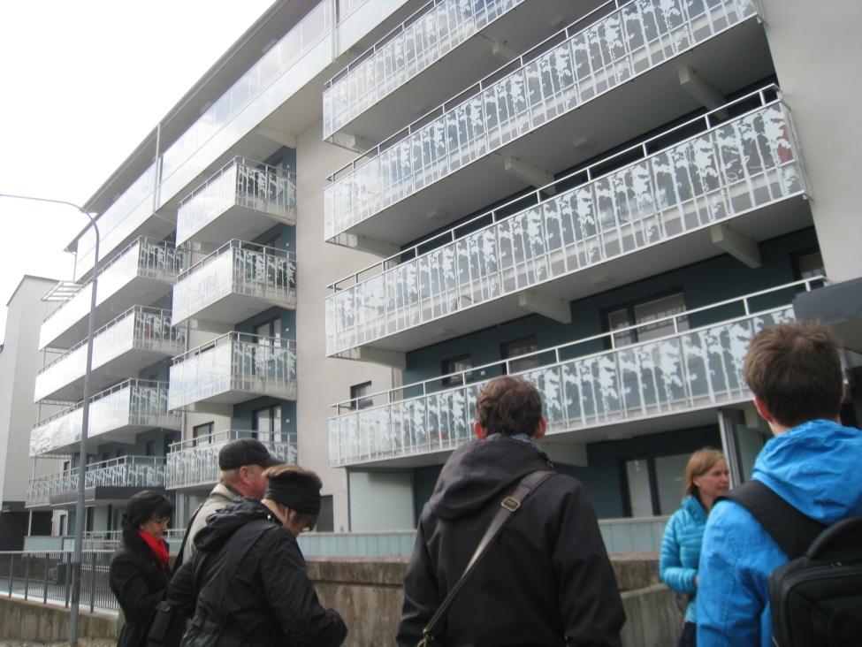
Environmental programme
The five-year Sustainable Järva project will conduct a dialogue with residents in seven apartment blocks to improve energy efficiency in 350 homes. The project covers several residential buildings.
Project includes a broad commitment to invest in sustainable transport, promote cycling, and educate local residents on climate and environmental issues.

Slide 10
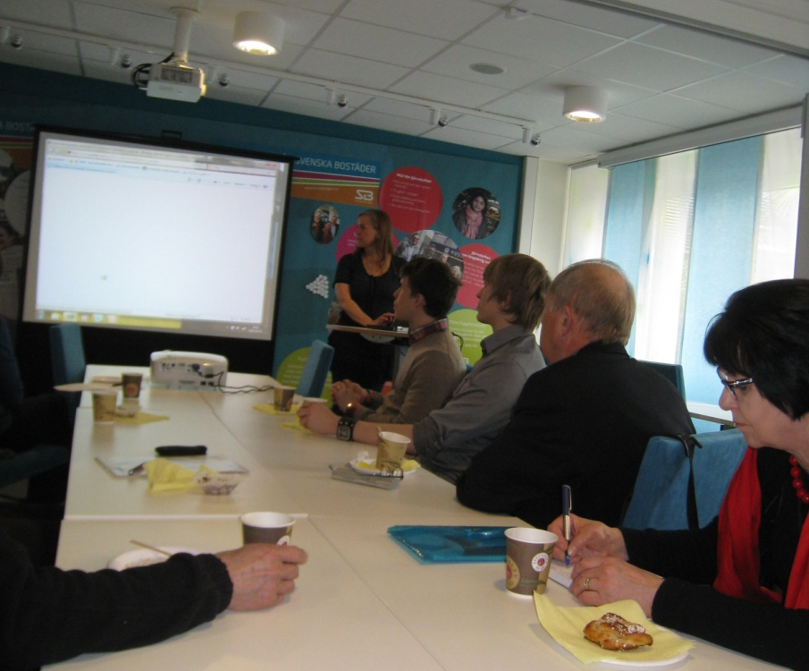
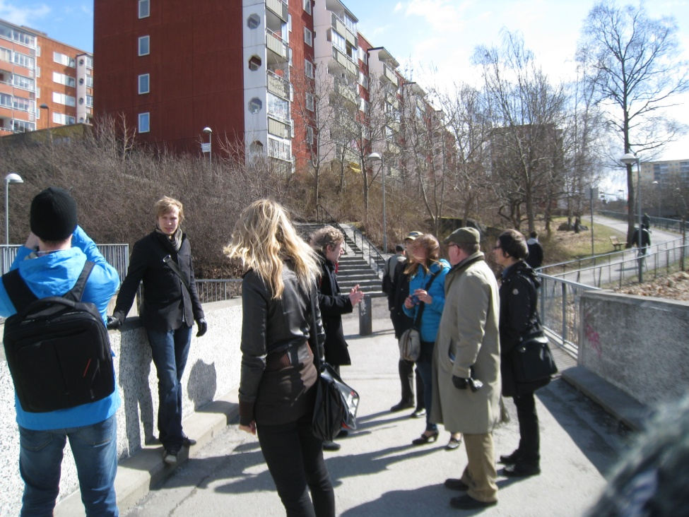
Renovation halves energy consumption
Halved energy consumption, energy from renewable sources and a good indoor climate are some of the project’s targets. The national requirements for new properties are 110 kWh/m².
Energy efficiency will be improved by either tradional on-site renovations or by fitting prefabricated facade elements. The two techniques will then be evaluated from an environmental, economoic and aestethetic perspective.

Slide 11
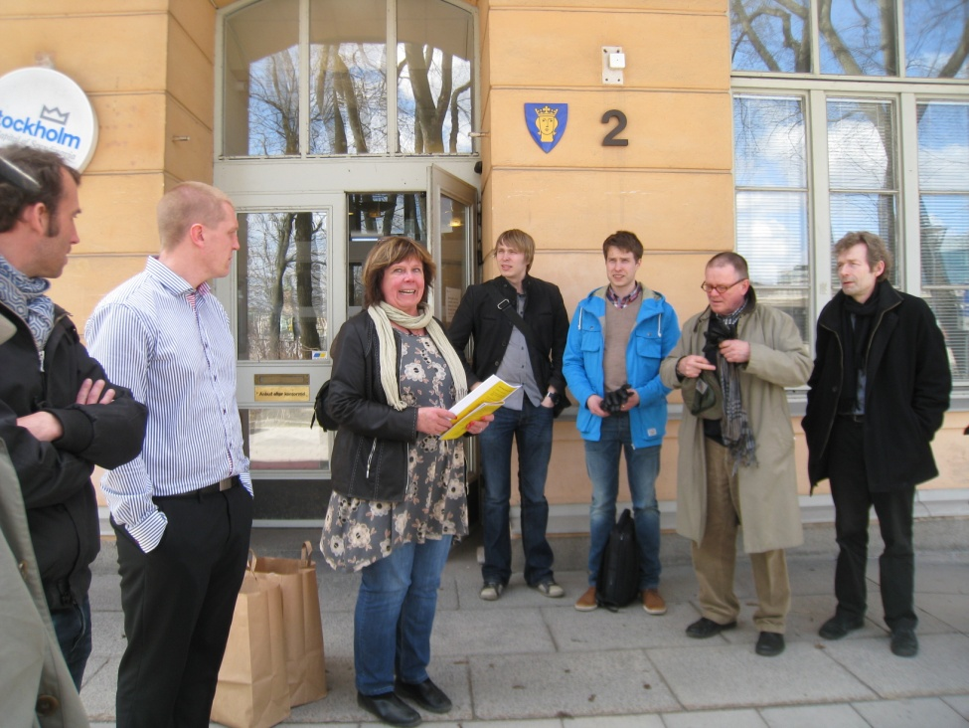
Stockholm Office for Real Estate Management –
Fastighetskontoret
The aim of the City of Stockholm Office for Real Estate Management is to reduce carbon dioxide release 12,5% and greenhouse gas 25% from 2008 levels.
Green IT is the collective name for the measures designed to reduce our environmental impact with the aid of IT.
Notes:
Energy consumption by the city’s own buildings and facilities shall be reduced by 10 per cent from 2006 levels.

Slide 12
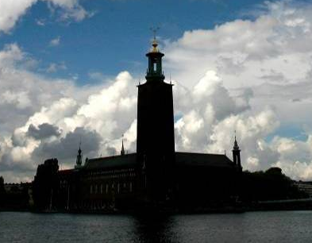
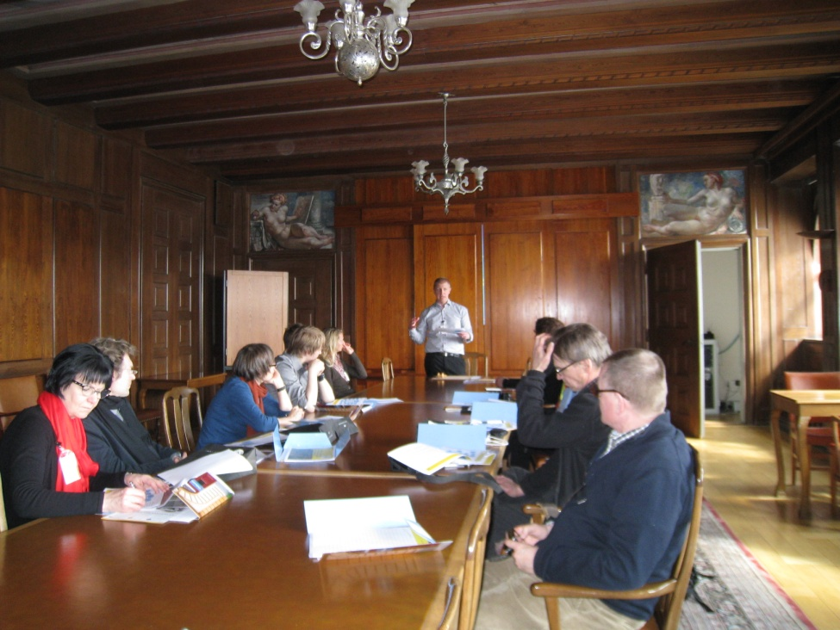
The city hall - Stockholm stadshuset
The city hall, where the Nobel Prize Banquet takes place every year, is an imposing brick building in the city centre.
The city hall is considered one of Sweden's foremost examples of national romaticism in architecture.
Notes:
Energy consumption by the city’s own buildings and facilities shall be reduced by 10 per cent from 2006 levels.

Slide 13
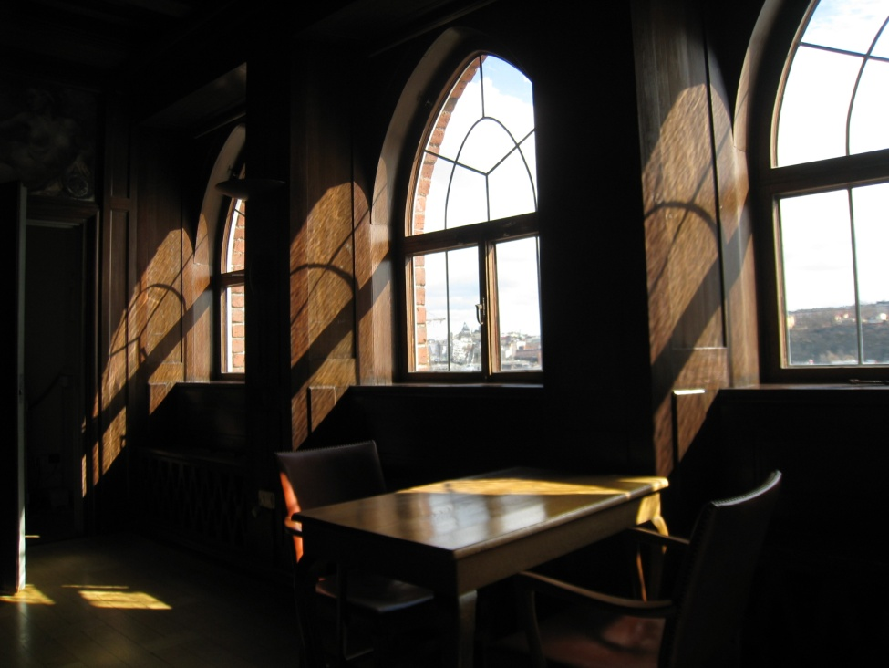
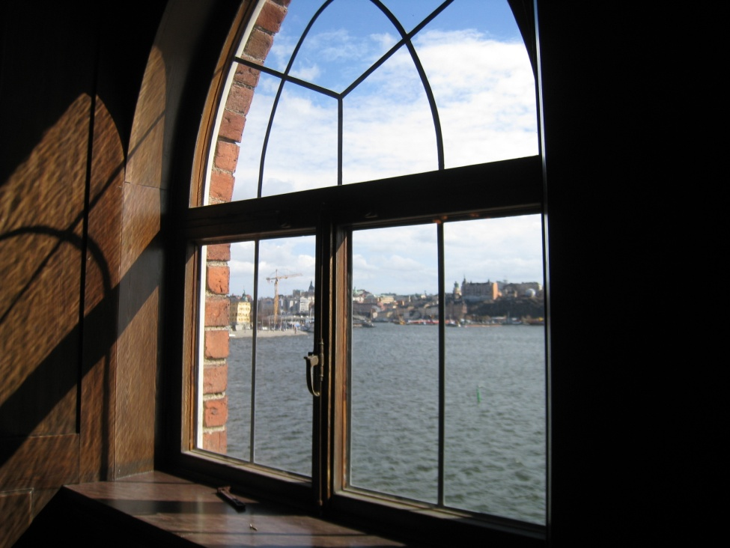
Green IT
Tommy Waldnert from the Real Estate Administration told about the refurbisment work that has been done, mainly concentrating on the Green IT. It involves: 1) using information technology to reduce our environmental impact, and 2) reducing the energy consumption and environmental impact of the IT sector.
Heating, ventilation and lighting can be controlled in line with tenant requirements, using IT-based control systems. Actions include developmenting of new technology designed to reduce energy-related emissions, and turning off lights in empty buildings and installing presence control.

Slide 14
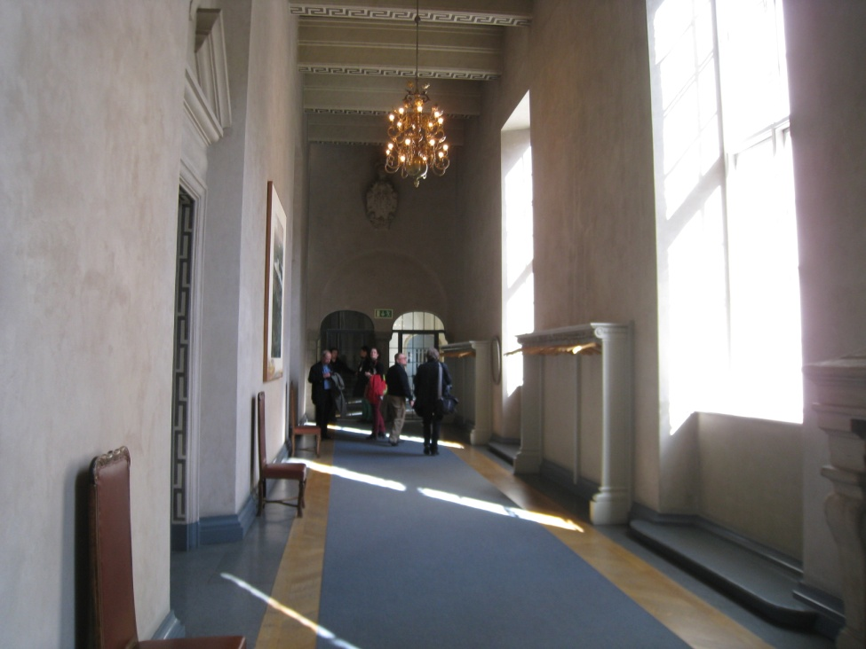
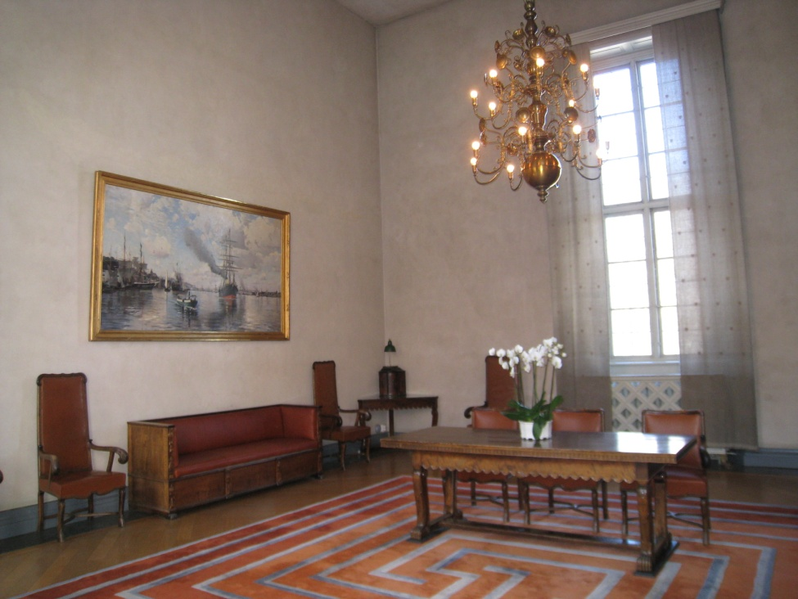
LED technology in a cultural environment
The major challenge was finding an energy efficient light source that would look similar to the chandelier bulbs and be visually appealing.
It should also have clear glass, provide the same warm light and emit an adequate amount of light, similar to the incandescent lamps.

Slide 15
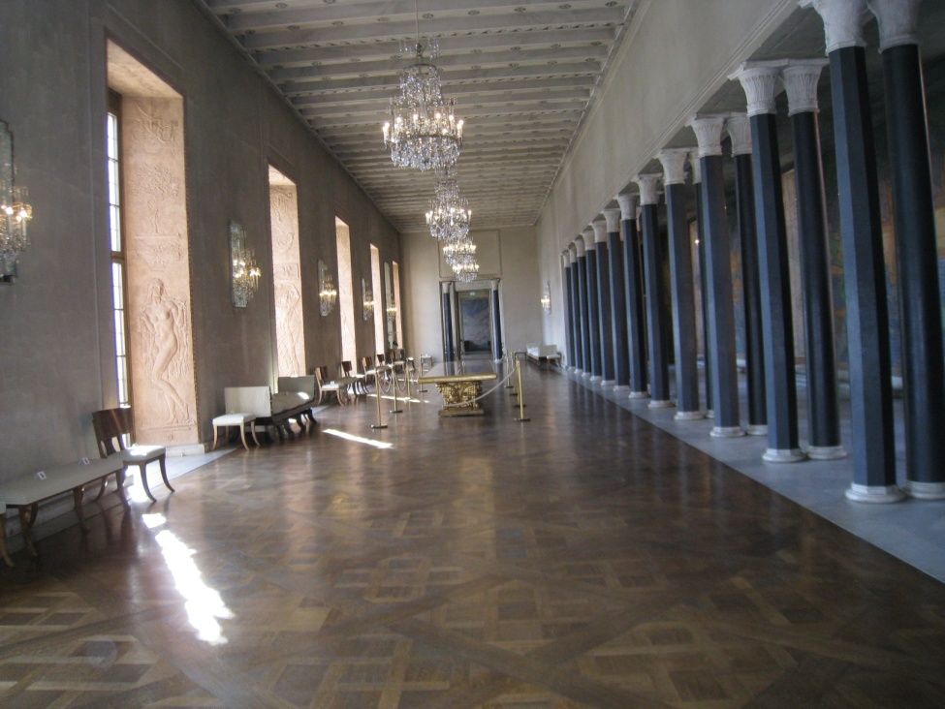
Energy savings and lower maintenance costs
All the clear chandelier 40 W bulbs in Prince Gallery have been replaced with an E14 cap base. A total of 126 Philips LED Novallures were installed.
By introducing LED lighting in the Prince’s Gallery, the installed power has been slashed by 92.5%.
Stadshuset is saving over 20,000 kWh a year, a reduction in CO2 emissions of over 2 tonnes (calculated as 100 g of CO2 per kWh).
The LED Novallure lamps have a lifetime 20 times longer than the previous chandelier bulbs. In the future they will only have to change the lamps every four or five years.
Several other LED-projects have been conducted and all of them shows that light-emitting diode technology is working also in sensitive cultural environment.

Slide 16
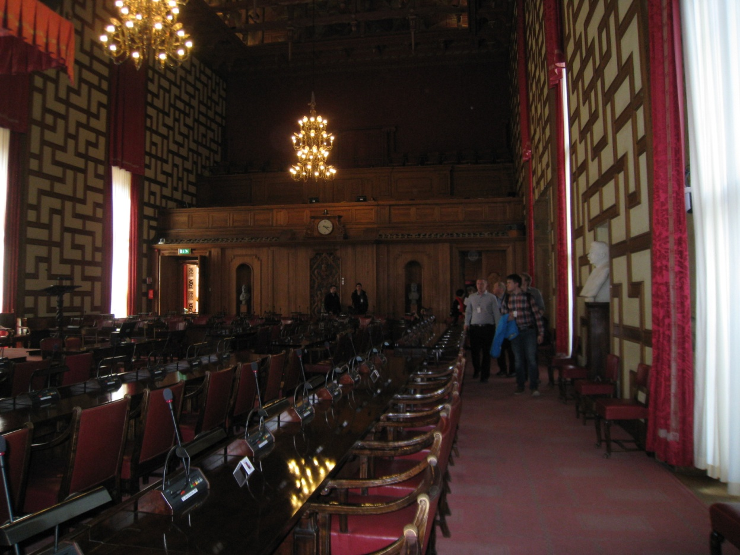
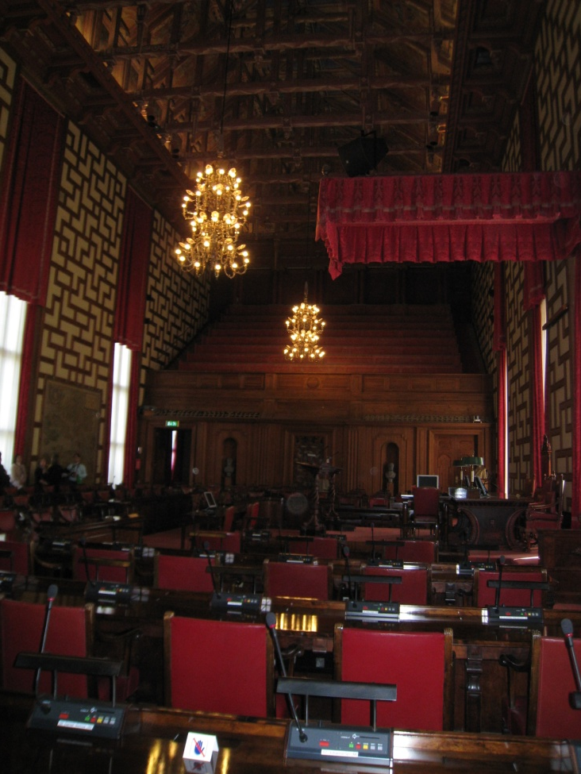
The city council chamber
The city hall is the building of the Municipal Council for the city of Stockholm.

Slide 17
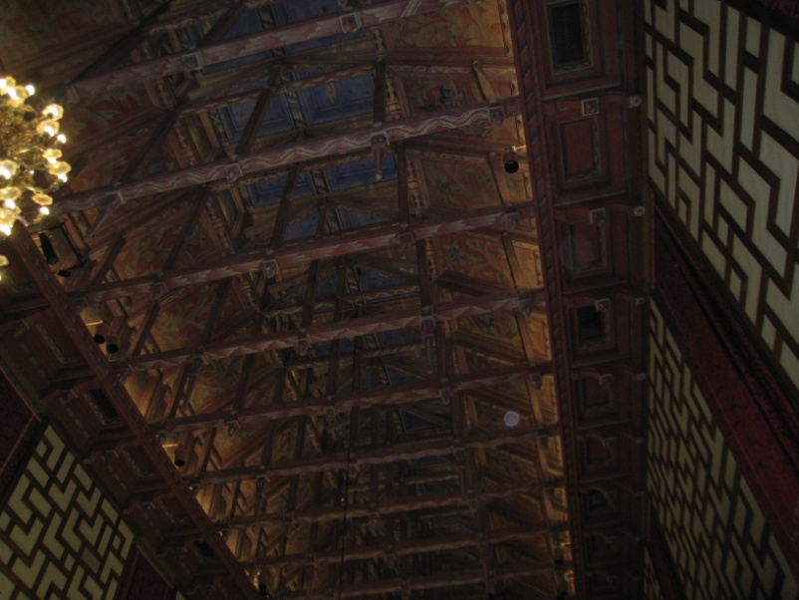
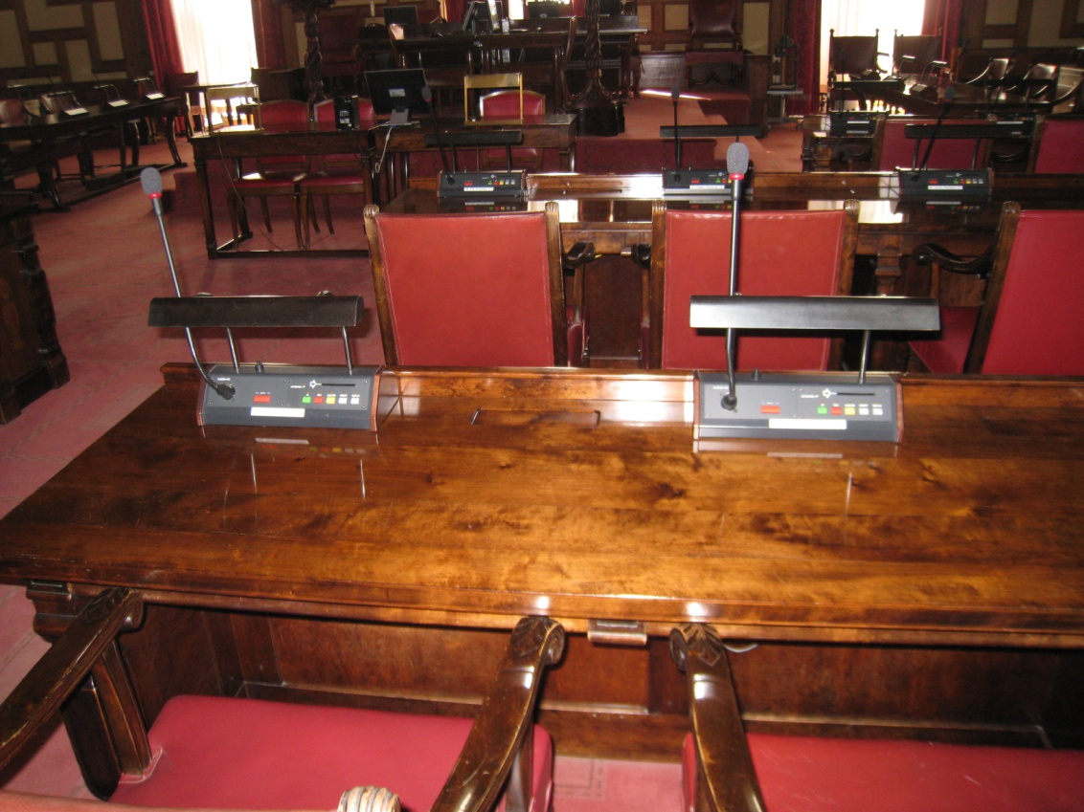
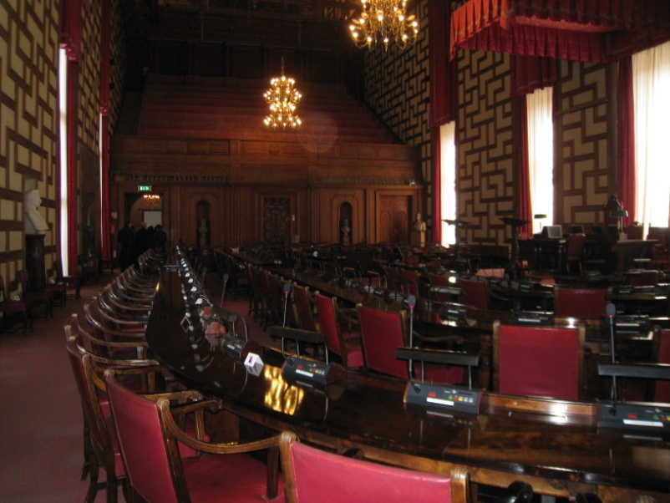
The city council chamber

Slide 18
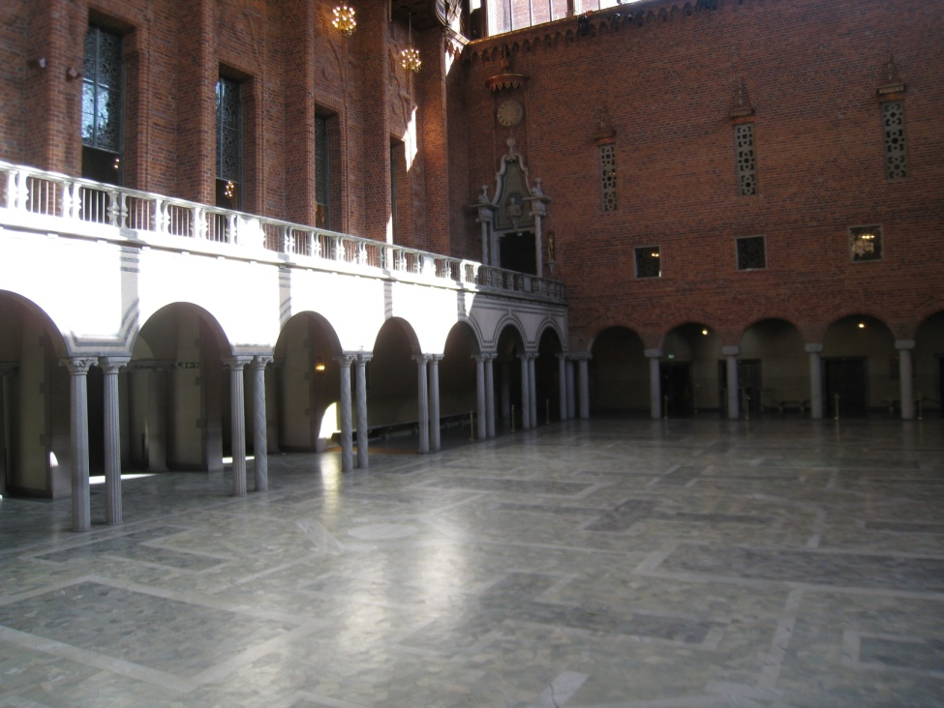
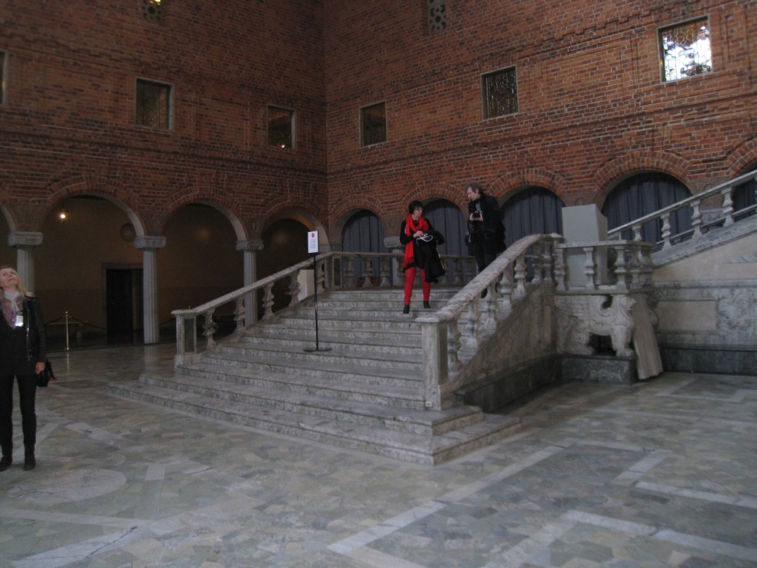
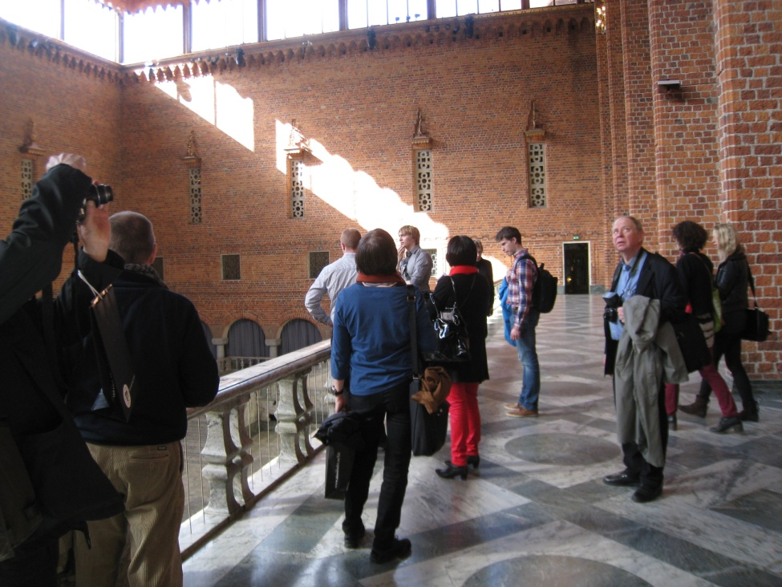
Blå Hallen
The Blue Hall is known as the dining hall used for the banquet held after the annual Nobel Prize award ceremony.

Slide 19
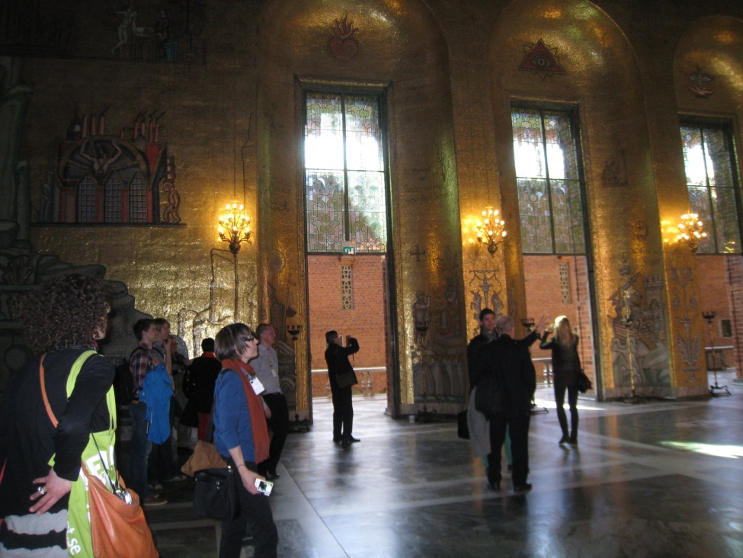
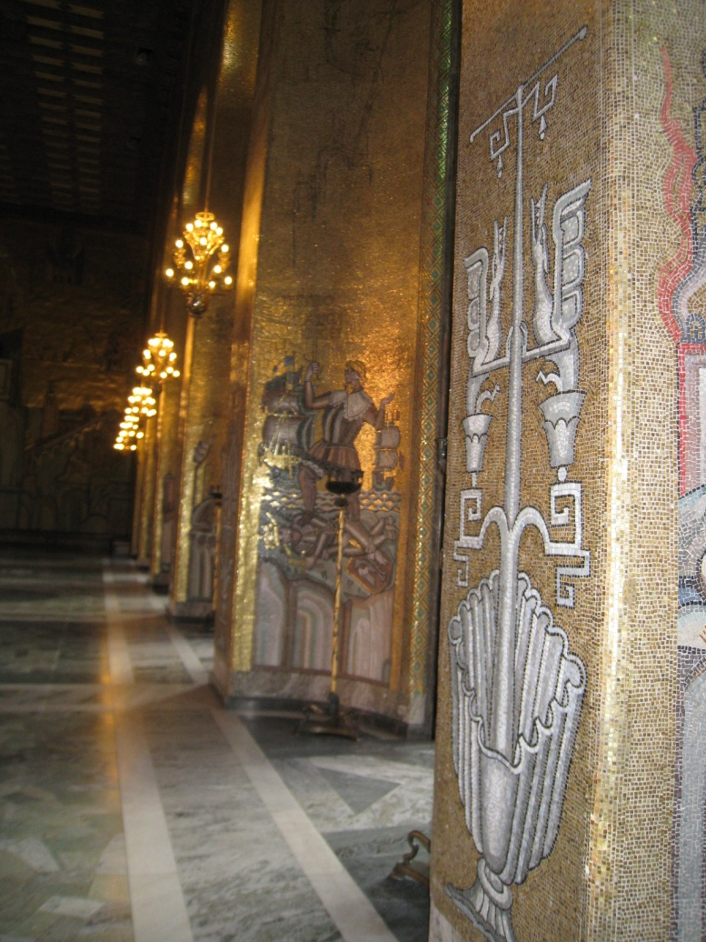
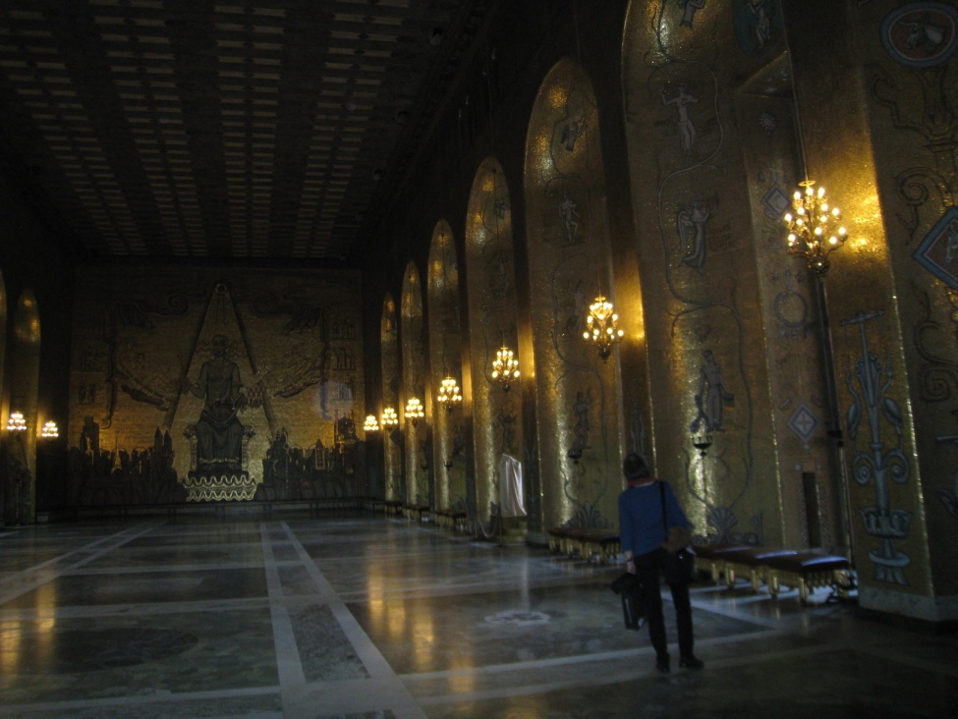
Gyllene Salen Banketten
Above the Blue Hall lies the Golden Hall (Gyllene Salen), named after the decorative mosaics made of more than 18 million tiles.

Slide 20
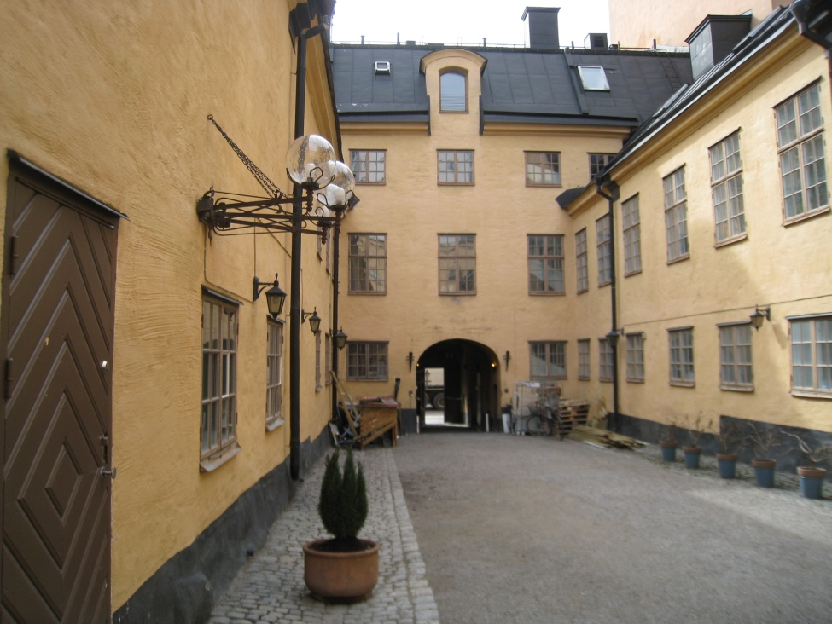
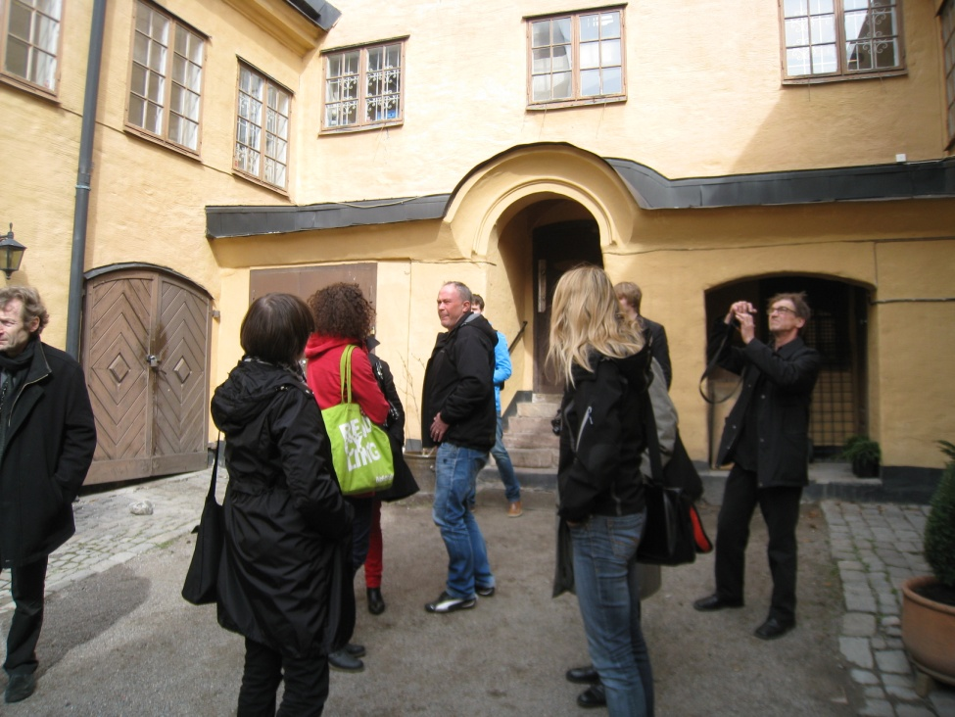
Stadsholmen
Stadsholmen owns about 280 pieces of real estate with around 1 650 residential buildings and 765 apartments Stockholms Stads bostadsförmedling AB is responsible for all external brokerage of Stadsholmens residential buildings. Several of them have the highest protection classification.
Notes:
Energy consumption by the city’s own buildings and facilities shall be reduced by 10 per cent from 2006 levels.

Slide 21
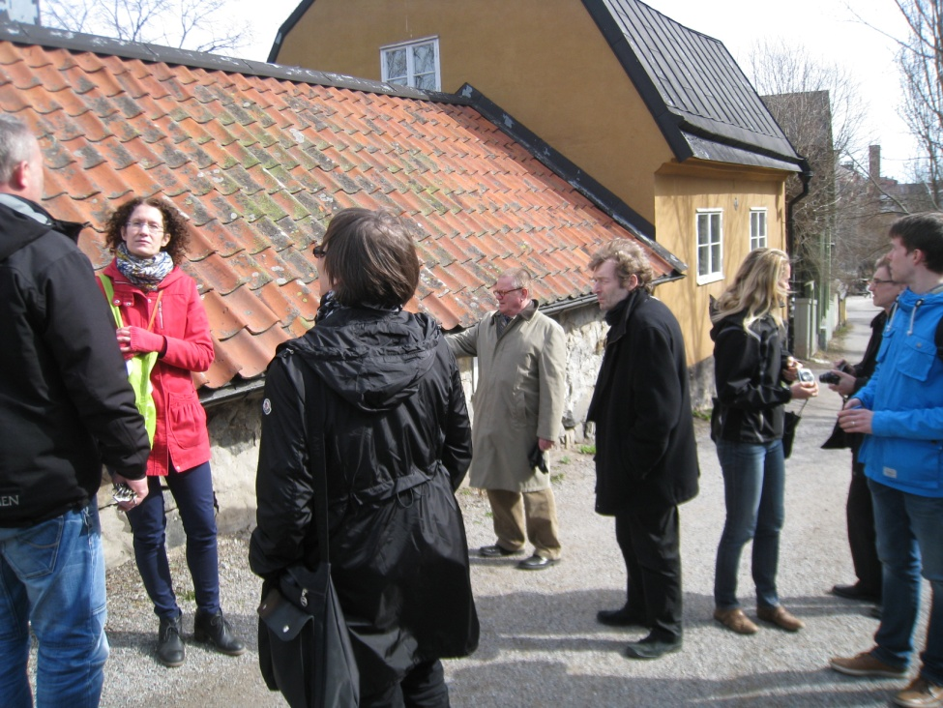
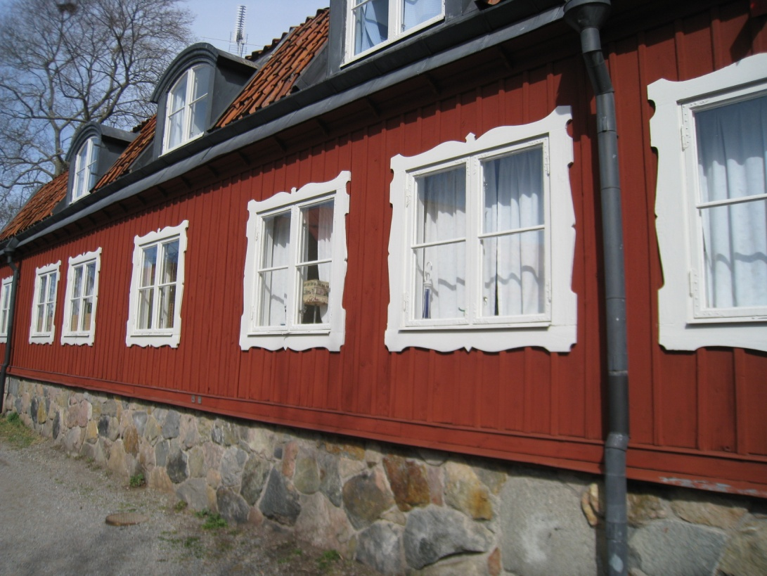
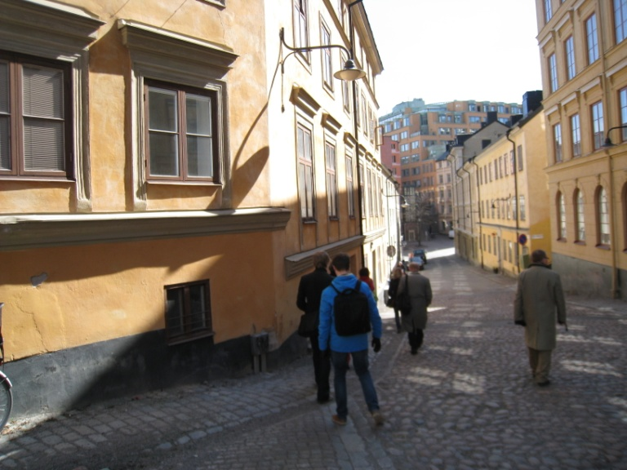
Stadsholmens wooden houses

Slide 22
Kiinko thanks all the guides and the participants for a rewarding and informative excursion.

